Slide 1


Slide 2


Slide 3


Slide 4
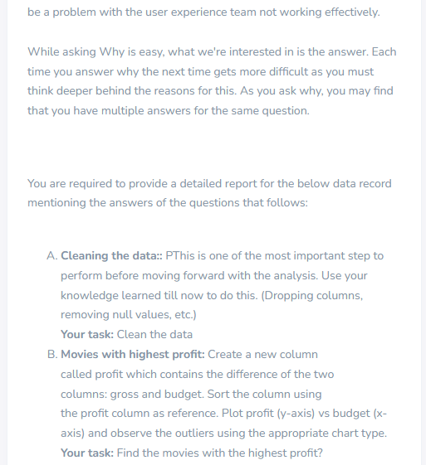

Slide 5
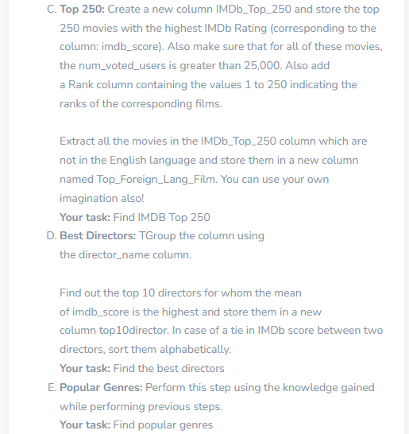

Slide 6
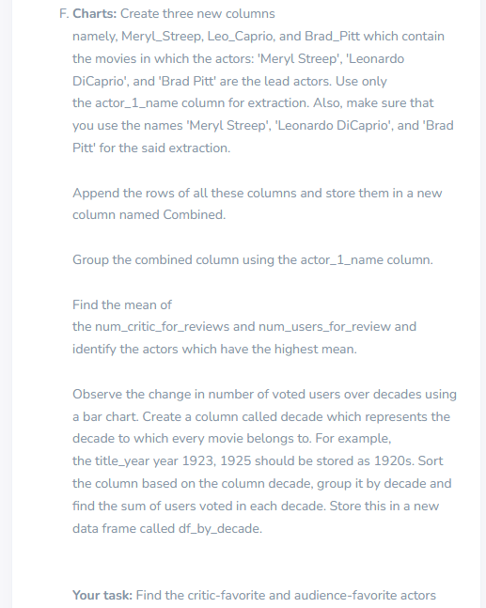

Slide 7
IMDB MOVIE ANALYSIS
A.Cleaning the data:
1.Removed all blank cells.
2.Removed all duplicate cells/records in movie_title column.
3.Dropped all empty columns.
4.Removed all cells that contains formula errors,text errors,logical errors and general errors.
5.Changed all Text to upper/lower/proper case to make it all consistent.
6.Cleared all formatting to have a clean data.

Slide 8
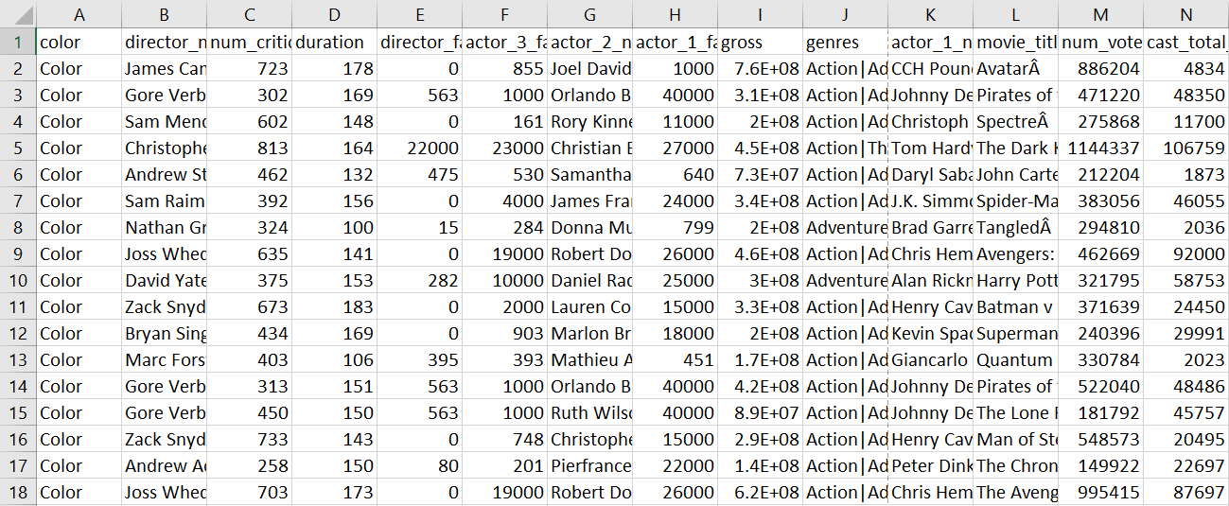

Slide 9
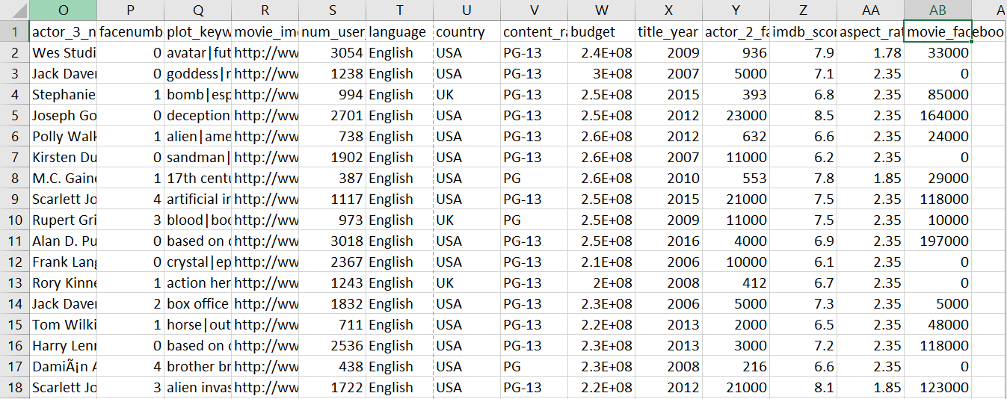

Slide 10
B. Movies with highest profit:
Top 10 movies with highest profit of a chart with profit (y-axis) vs budget (x- axis)

Slide 11
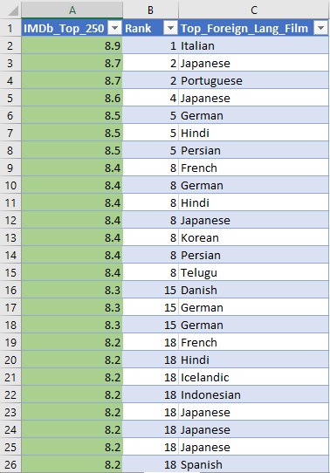
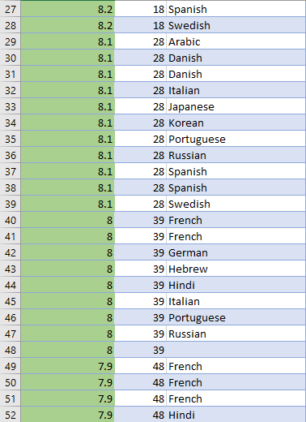
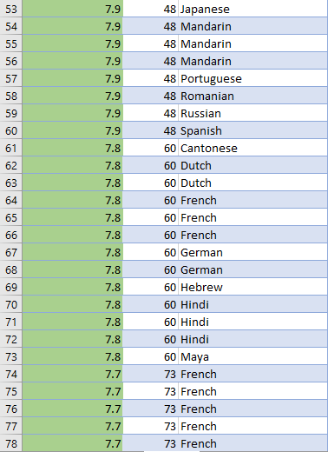
C. Top 250:

Slide 12
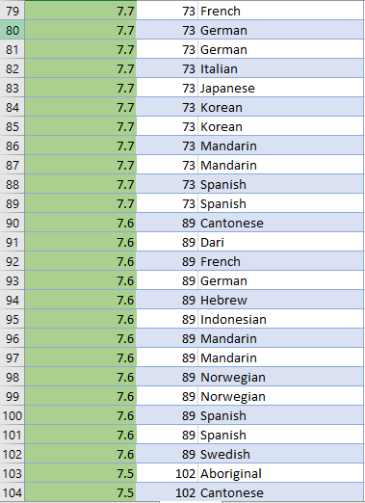
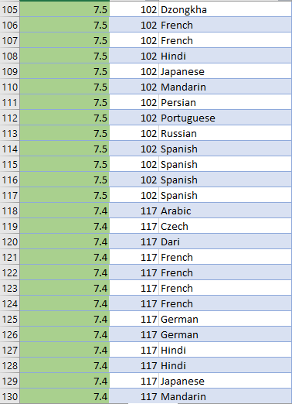
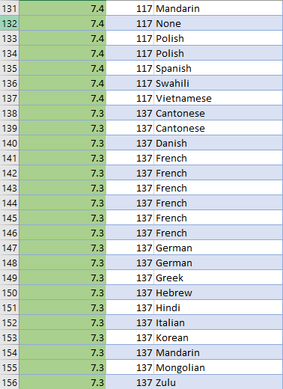

Slide 13
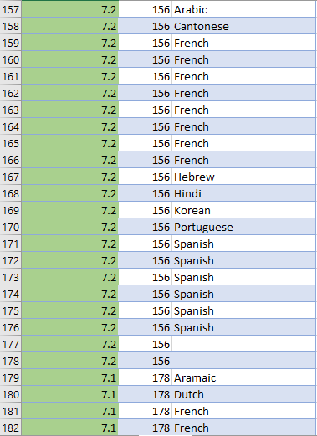
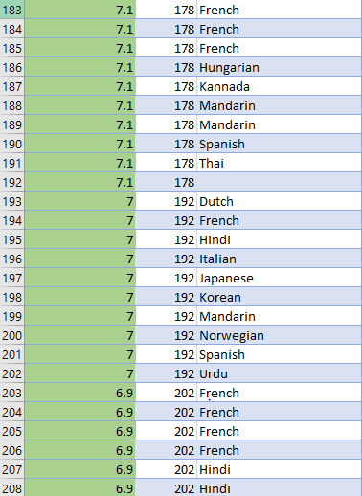
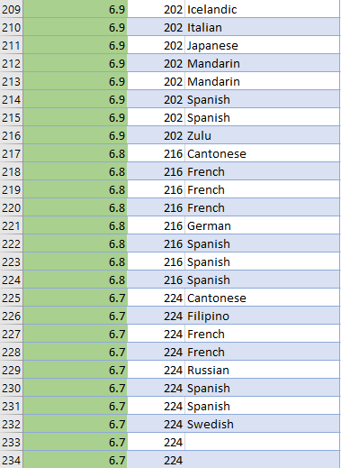

Slide 14
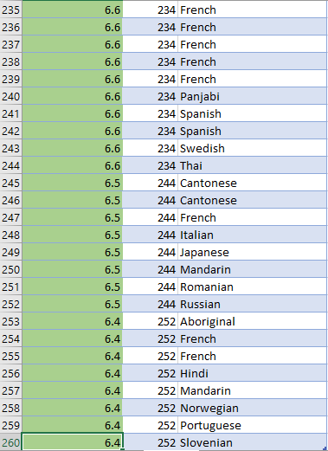

Slide 15
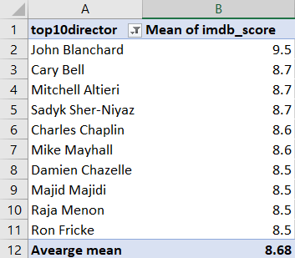
D. Best Directors

Slide 16
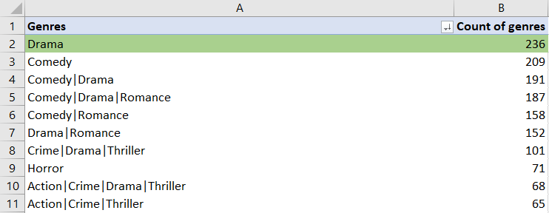
E. Popular Genres:
Drama is the most popular genres

Slide 18
F. Charts:
Create three new columns namely, Meryl_Streep, Leo_Caprio, and Brad_Pitt which contain the movies in which the actors: 'Meryl Streep', 'Leonardo DiCaprio', and 'Brad Pitt' are the lead actors. Use only the actor_1_name column for extraction. Also, make sure that you use the names 'Meryl Streep', 'Leonardo DiCaprio', and 'Brad Pitt' for the said extraction. Append the rows of all these columns and store them in a new column named Combined. Group the combined column using the actor_1_name column.

Slide 19
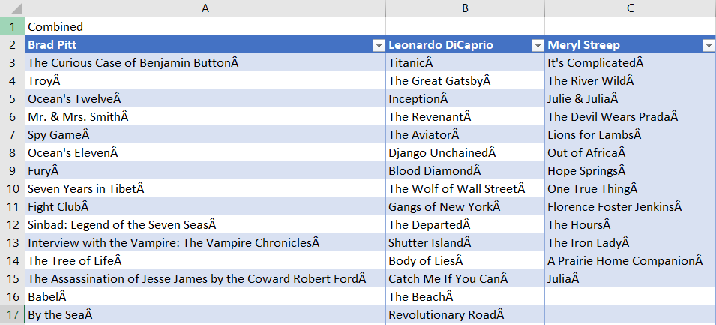


Slide 20
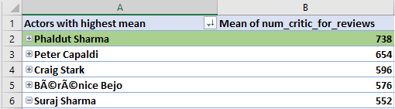
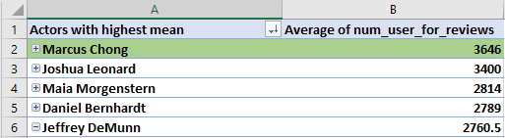
Find the mean of the num_critic_for_reviews and num_users_for_review and identify the actors which have the highest mean.

Slide 21
Observe the change in number of voted users over decades using a bar chart.

Slide 22
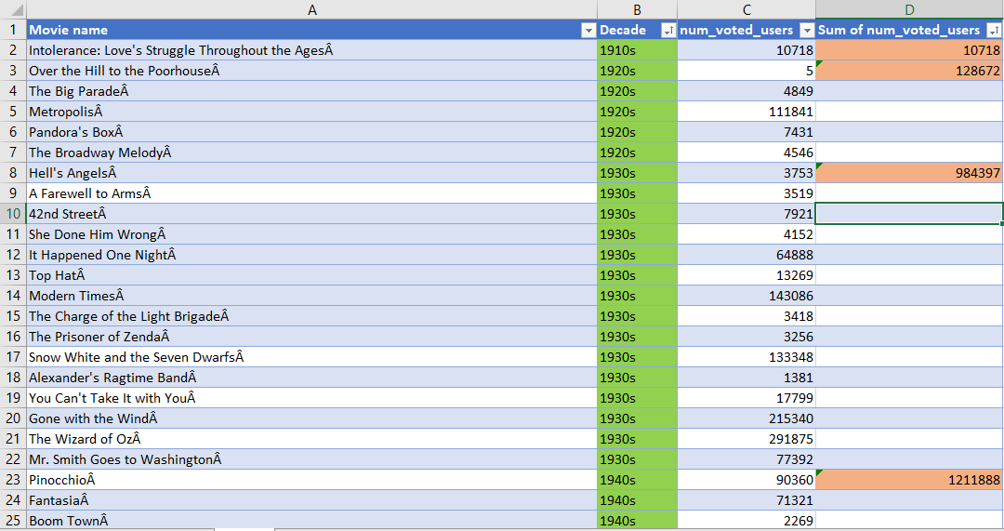
Create a column called decade which represents the decade to which every movie belongs to. For example, the title_year year 1923, 1925 should be stored as 1920s. Sort the column based on the column decade, group it by decade and find the sum of users voted in each decade. Store this in a new data frame called df_by_decade.

Slide 23
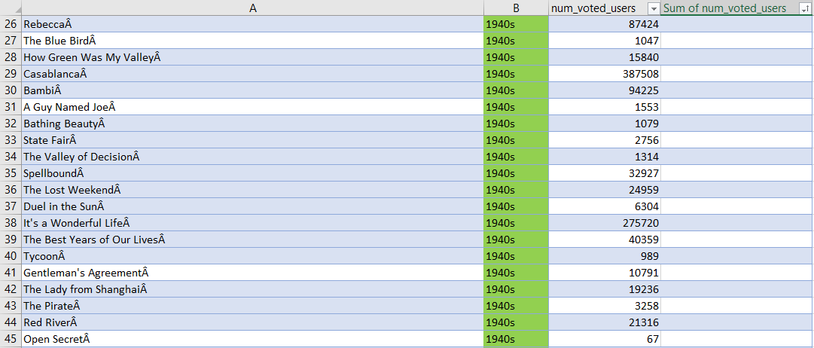
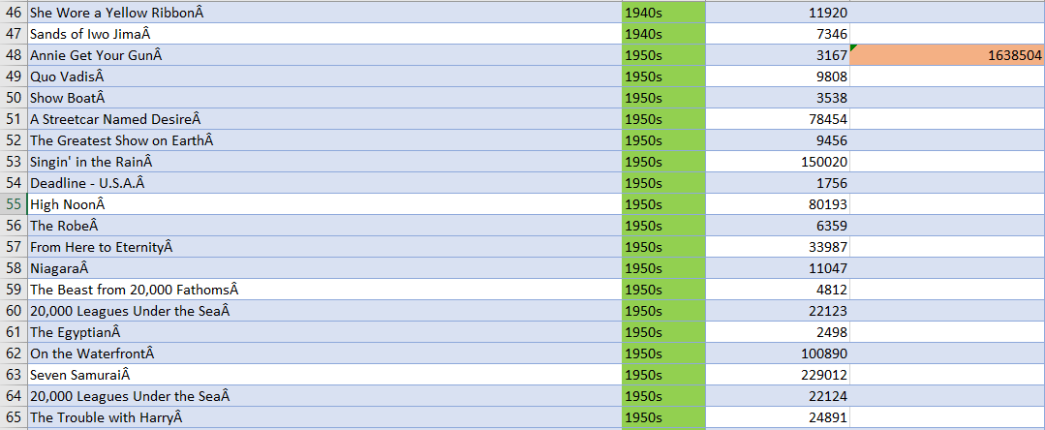

Slide 24
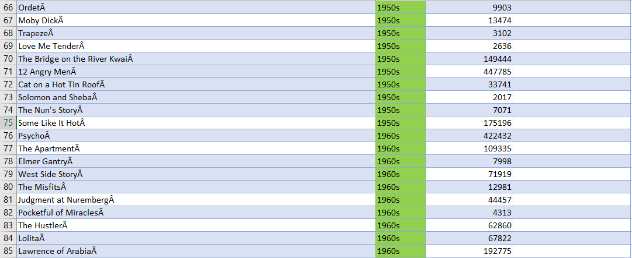
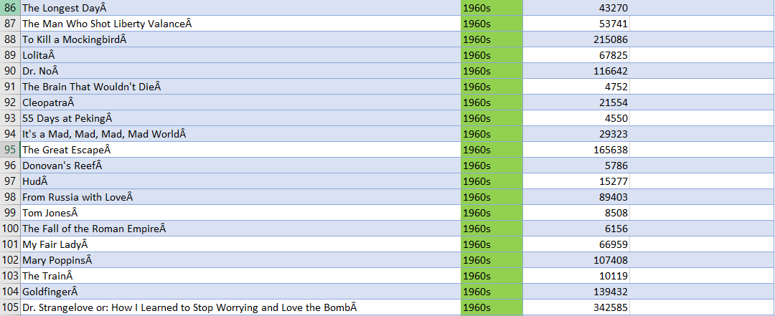

Slide 25
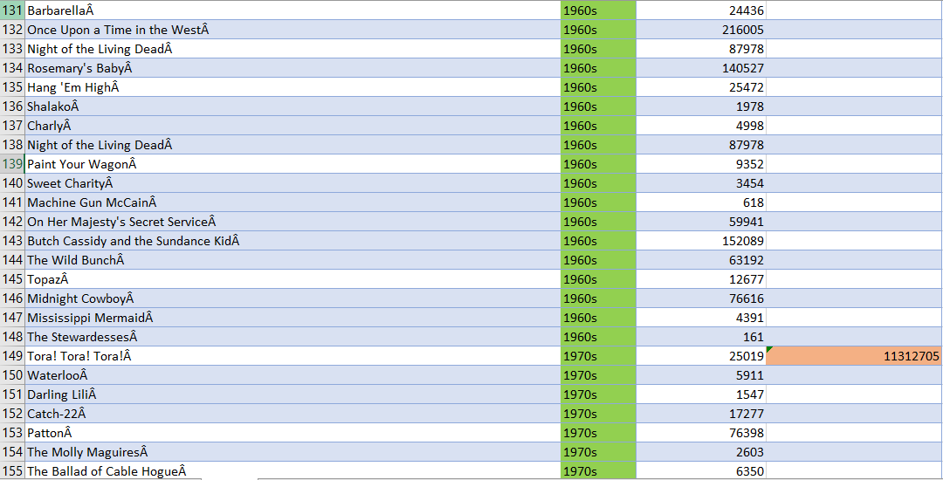
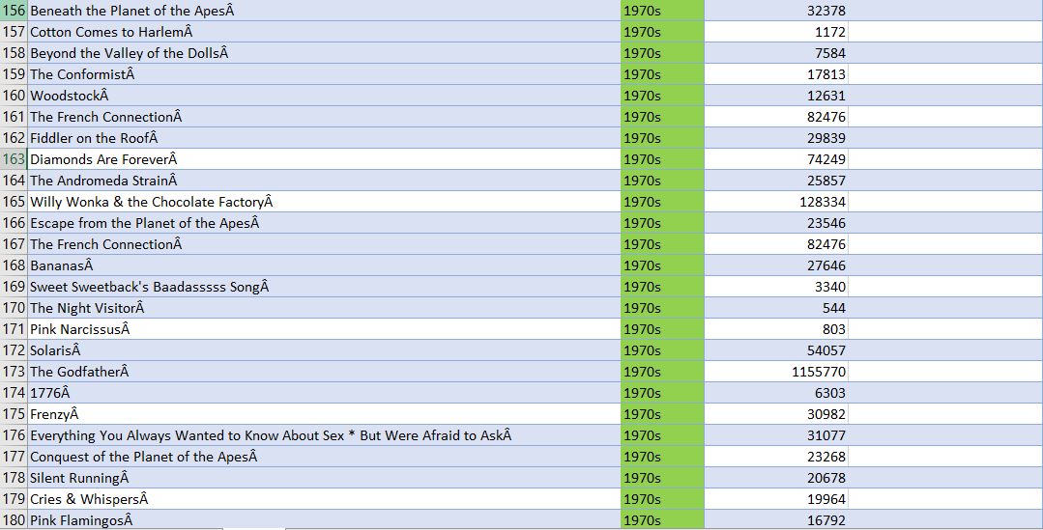

Slide 26
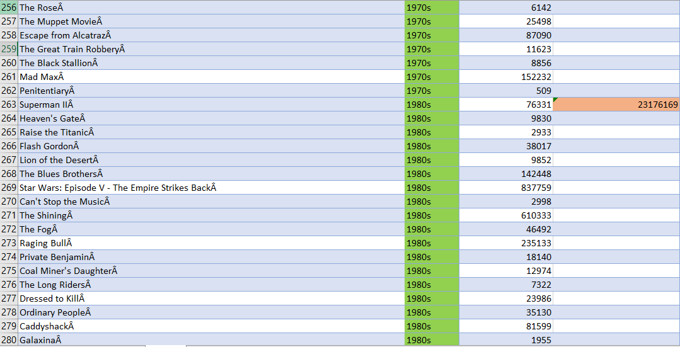
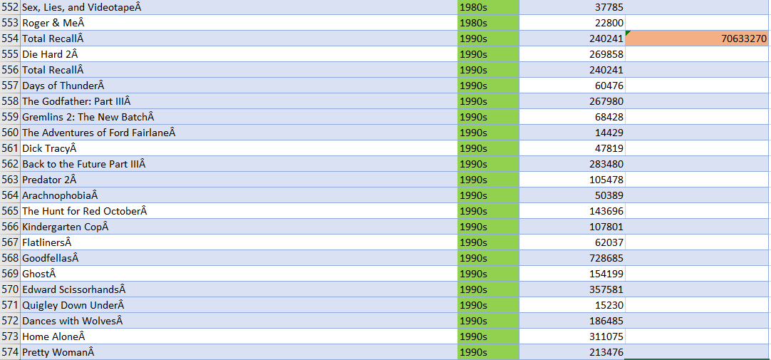

Slide 27
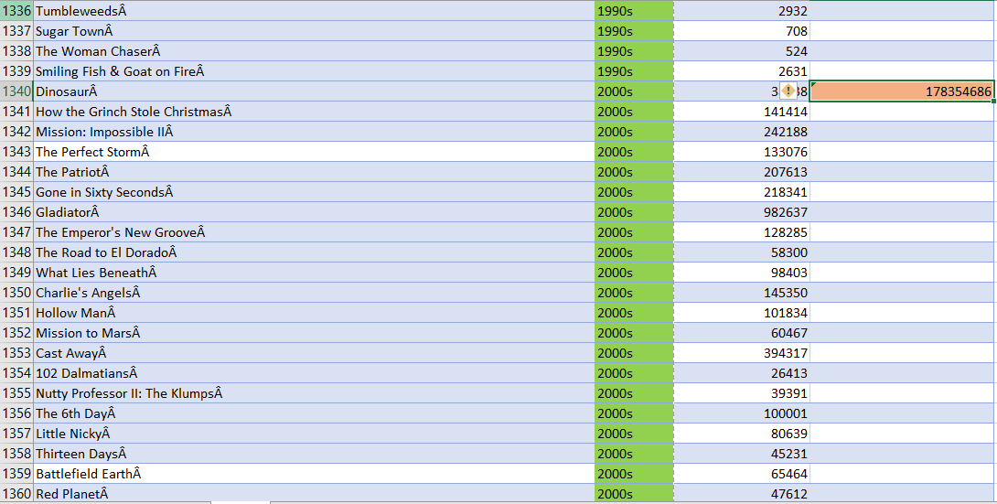
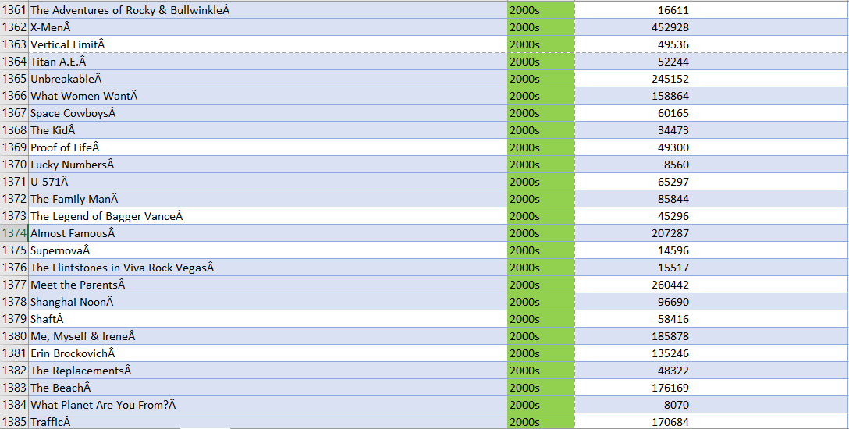

Slide 28
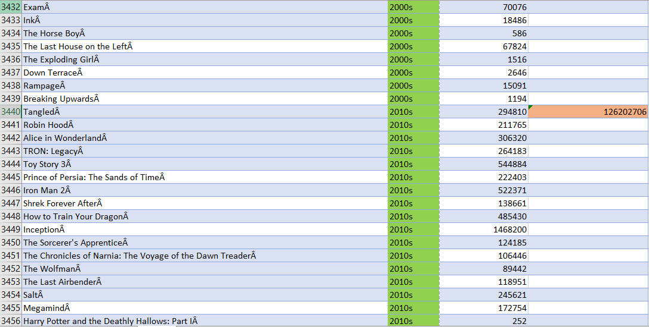
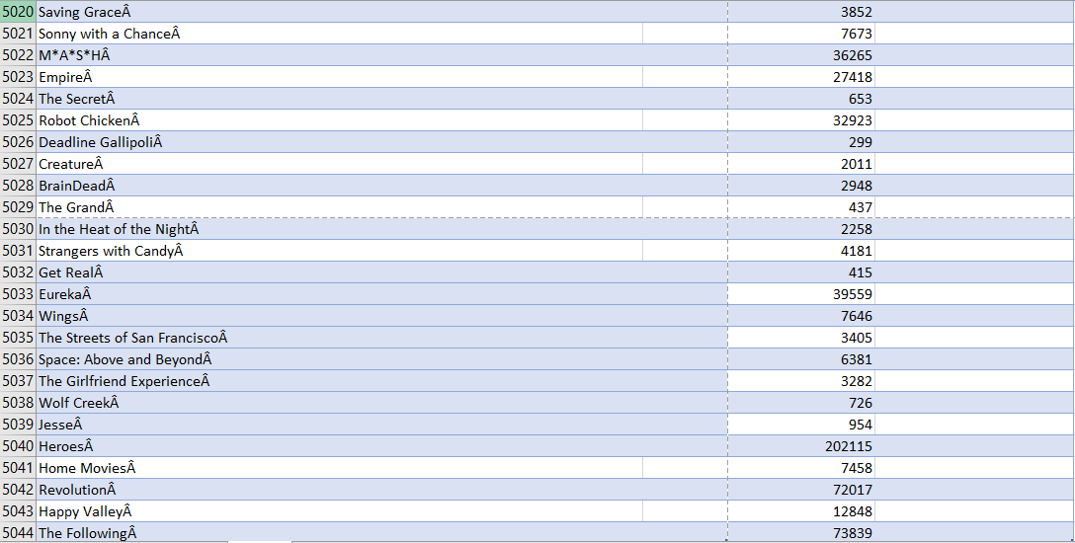

Slide 29
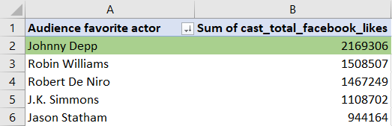
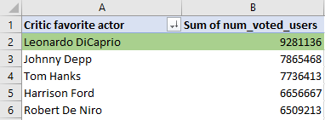
Top 5 audience-favorite actors
Top 5 critic-favorite actors

